Slide 1
Bringing GIS Analysis to Life using Python Notebooks
Michael G. Leahy PhD – mleahy@esri.ca

Slide 2
Workshop Agenda
Introduction: Jupyter Notebooks -> ArcGIS Notebooks
Why? What?
Getting Started:
Basics of working with Jupyter Notebooks
Notebooks in ArcGIS Pro
Hosted Notebooks in ArcGIS Enterprise, ArcGIS Online
Geospatial Data Science Notebook samples:
Data wrangling
Data exploration
Data analysis

Slide 3
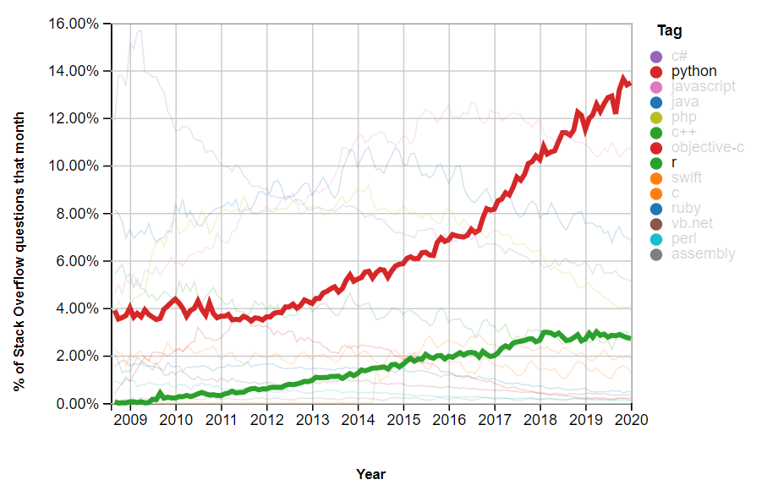
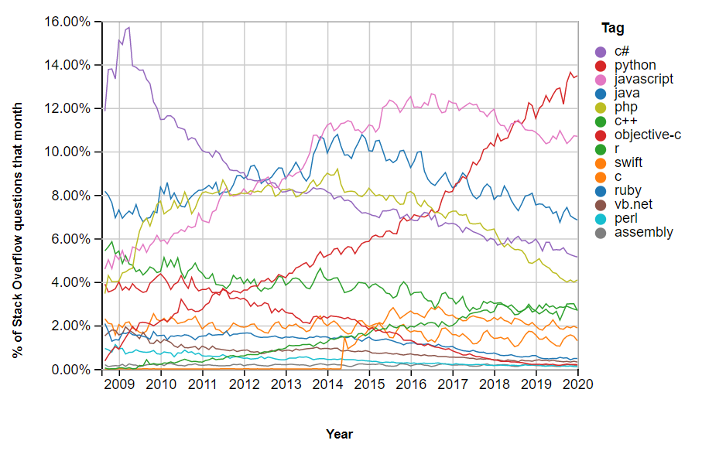
Python
Arguably the most popular programming language today
Why?
Active/supportive community
Big Data, ML/DL/AI
Many high-quality libraries
Reliable and efficient
Highly accessible (easy to learn and use)
https://insights.stackoverflow.com/trends

Slide 4
Jupyter Notebook
A popular way to compose documents that include:
Rich formatted text
Embedded images
Multimedia
Math formulas
All interlaced with live executable code and visualization of outputs
Why?
Everything in one place
Sharable
Language independent
Customizable
Reproducibility & Transparency
Teaching
Iterative exploration
Python!

Slide 5




ArcGIS Notebooks
Notebooks – around since '80s
> IPython (2001)
> Jupyter (2014, multi-language)
ArcGIS:
Geoprocessing with Python since ArcGIS 9.0 (2004)
2016: ArcGIS Notebooks =
Jupyter Notebook server
+ Python
+ ArcGIS API for Python (2016)
+ ArcPy
2019: Hosted Notebooks =
ArcGIS Notebook
+ ArcGIS Enterprise 10.7.1+
+ Notebook Server for ArcGIS
(or simply ArcGIS Online … soon)
2020: ArcGIS Pro Notebooks =
ArcGIS Pro 2.5+ (2020)
+ ArcGIS Notebooks

Slide 6







What can ArcGIS Notebooks do?
Data
Engineering
(Wrangling)
(Spatial) Data Analysis
ML / DL / AI
Automation
Collaboration
Storytelling
Iteration & Experimentation
(Learning)

Slide 7

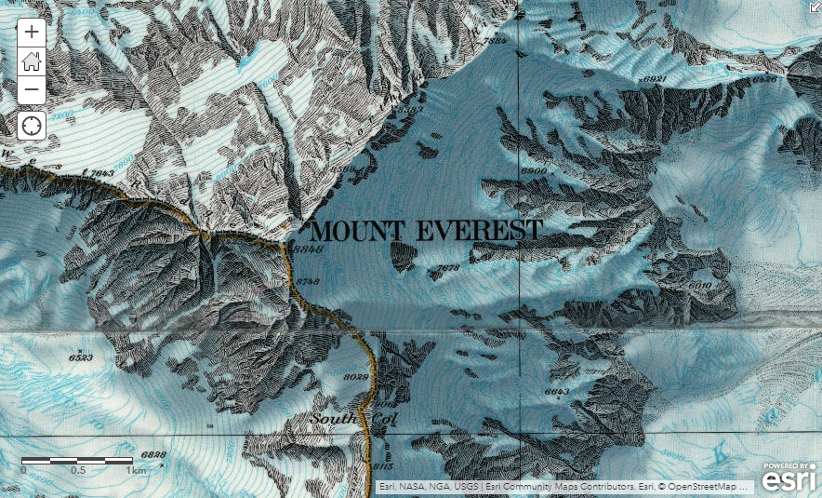
ArcGIS StoryMaps...
help you turn this...
(simple web maps)
…into this.

Slide 8
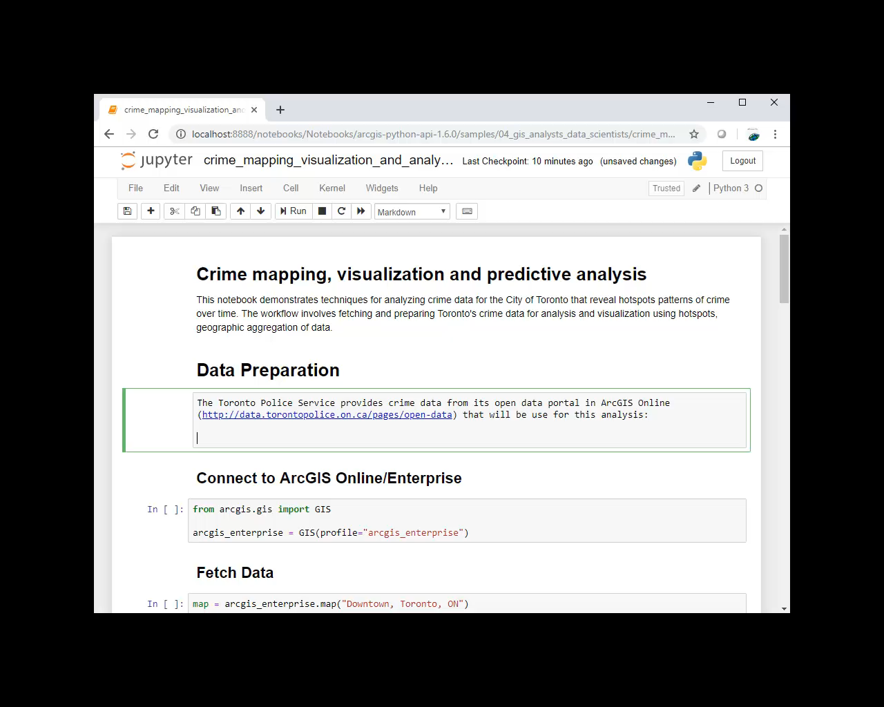
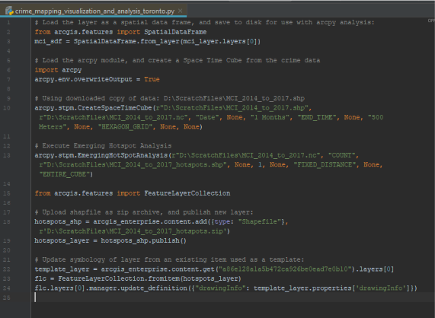
ArcGIS Notebooks…
help you turn this...
(python scripts)
…into this.

Slide 9
Getting Started...

Slide 10
Michael G. Leahy PhD – mleahy@esri.ca
ListServ: https://hed.esri.ca/studentlistserv
Twitter: @GIS4HEd

